Slide 1
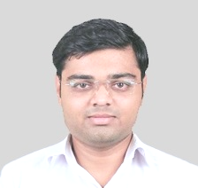
Software Engineering
(2301CS405)
Introduction Software Engineering
Prof. R. B. Gondaliya
Computer Engineering Department
rajkumar.gondaliya@darshan.ac.in
+91-9723232741

Slide 2
Teaching & Examination Scheme
Teaching Scheme
L | T | P | C
3 | 0 | 2 | 4
Examination Scheme |  |  |  | Total Marks
Theory Marks |  | Practical Marks |  | 100
SEE(E) | CIA (T) | SEE (P) | CIA(P)
40 | 30 | 20 | 10

Slide 3
Syllabus
Unit | Content | Total Hrs. | % Weightage
1 | Software Development Process Explain Software and Software Engineering: Defining Software, Software Application Domains, Characteristics of Software, Introduction of Software Engineering, Software Engineering layers, Software Processes/Software Development Life Cycle, Software Engineering practices, Software Myths, Generic Framework activities, Umbrella activities. Project Process Models: The Waterfall Model, Incremental Process Model, Evolutionary Process Model (Prototype Model, Spiral Model), RAD Model, Component-Based Process Model. | 11 | 20
2 | Agile Development Agile Models: Defining Agility, Agile Manifesto and Principles, Agile Process, Extreme Programming, Adaptive Software Development, Scrum, Dynamic System Development Method Agile Scrum Framework: Introduction to Scrum, User Story Definition, Characteristics and Content of User Stories, Agile Estimation, Scrum Roles and Responsibilities, The Scrum Phases, Sprint Phases, Burn Down Chart, Tools for Agile Project Management. | 11 | 20
3 | Software Analysis and Design Software Analysis: Analysis and Identify Software Requirements, Requirement Engineering, Software Requirements Specification, Eliciting Requirements, Developing Use case, Requirement Modeling(Scenario based, Class-based, Behavioral, Flow-orientated & Data-orientated) Software Design: Design Concepts, Architectural Design, Component level Design, User Interface Design, Web Application Design | 11 | 20

Slide 4
Syllabus
Unit | Content | Total Hrs. | % Weightage
4 | Software Coding, Testing & Quality Management Software Coding & Testing: Code Review, Software Documentation, Testing Strategies, Testing Techniques and Test Case, Test Suites Design, Testing Conventional Application, Testing Object Oriented Application, Testing Web and Mobile Application Quality Assurance and Management: Quality Concepts and Software Quality Assurance, Software Review (Formal Technical Review), Software Reliability, The Quality Standard. | 11 | 20
5 | Project Management & Configuration Management Project Management: Software Metrics (Process, Product, Project), Software Project Estimation, Software Project Planning, Software Project Scheduling & Tracking, Risk Analysis & Management, Risk Strategies (Reactive vs. Proactive), Risk Identification, Risk Projection, Risk Refinement, Risk Mitigation, Monitoring and Management. Configuration Management: Type of Software Maintenance, Re-Engineering, SCM process, Version Control | 8 | 20

Slide 5
Reference Books
Roger S.Pressman, Software engineering- A practitioner’s Approach, McGraw-Hill International Editions
Ian Sommerville, Software engineering, Pearson education Asia
Pankaj Jalote, Software Engineering – A Precise Approach Wiley
Software Engineering Fundamentals by Ali Behhforoz & Frederick Hudson OXFORD
Rajib Mall, Fundamentals of software Engineering, Prentice Hall of India.
Engineering Software as a Service An Agile Software Approach, Armando Fox and David Patterson
John M Nicolas, Project Management for Business, Engineering and Technology, Elsevier

Slide 6
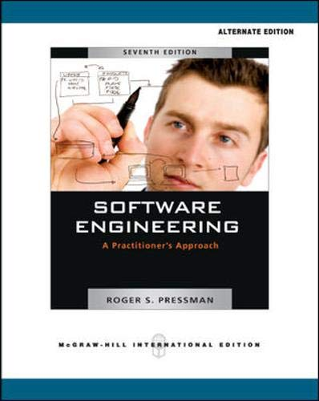
Roger S.Pressman, Software engineering

Slide 7
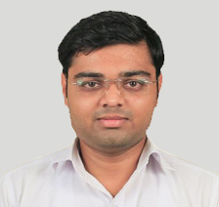
Software Engineering
(2301CS405)
Prof. R. B. Gondaliya
Computer Engineering Department
rajkumar.gondaliya@darshan.ac.in
+91-9723232741

